Slide 1
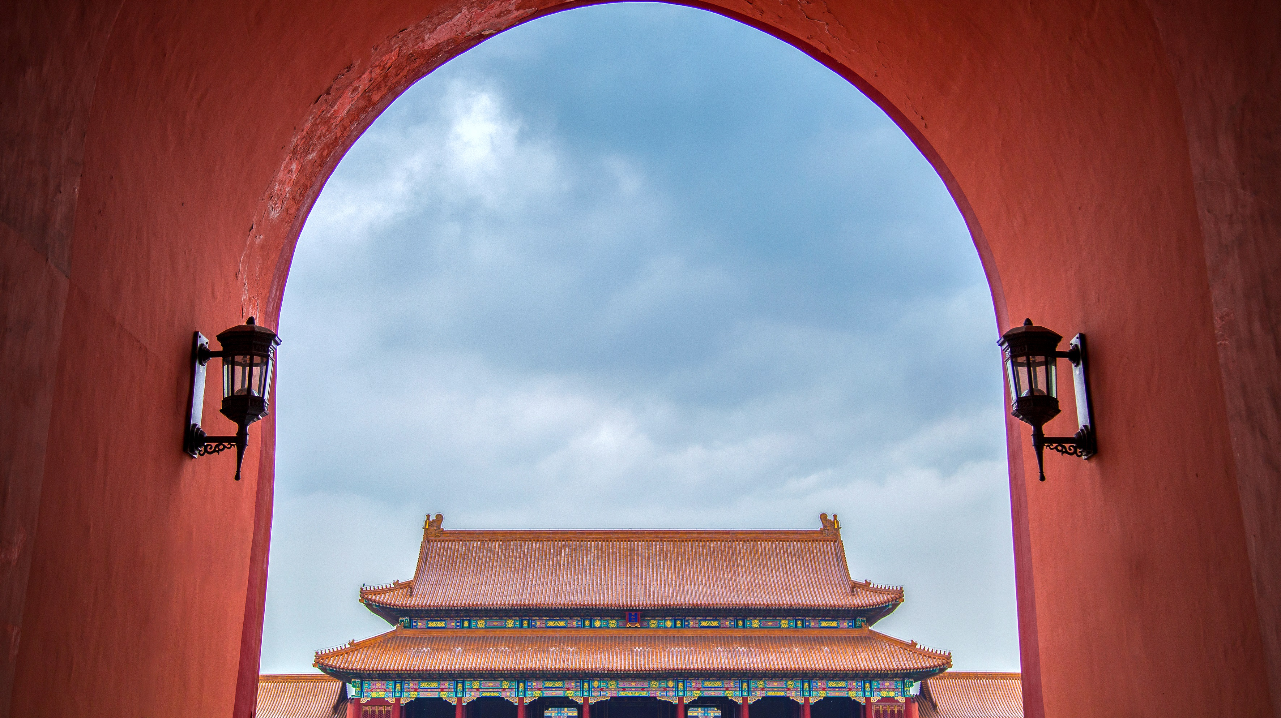
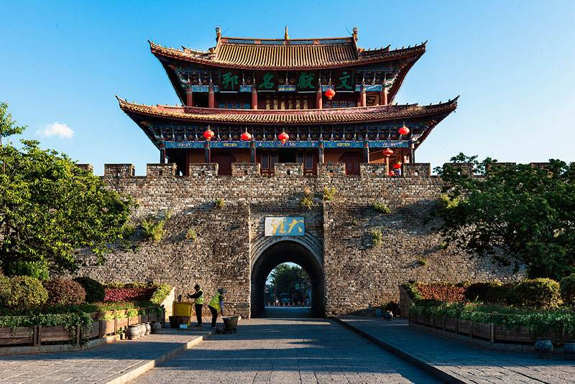
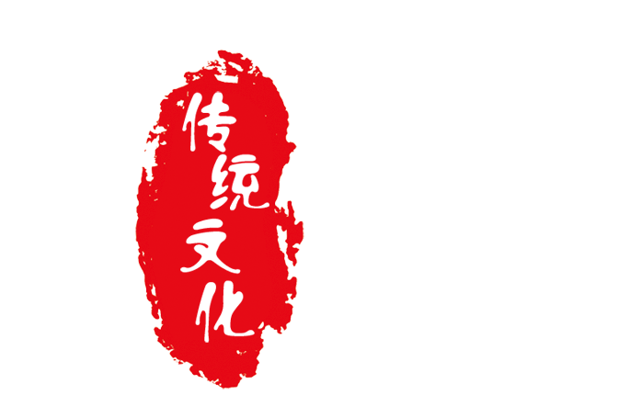
Beautiful Dali
A place you can't go without in your life.

Slide 2
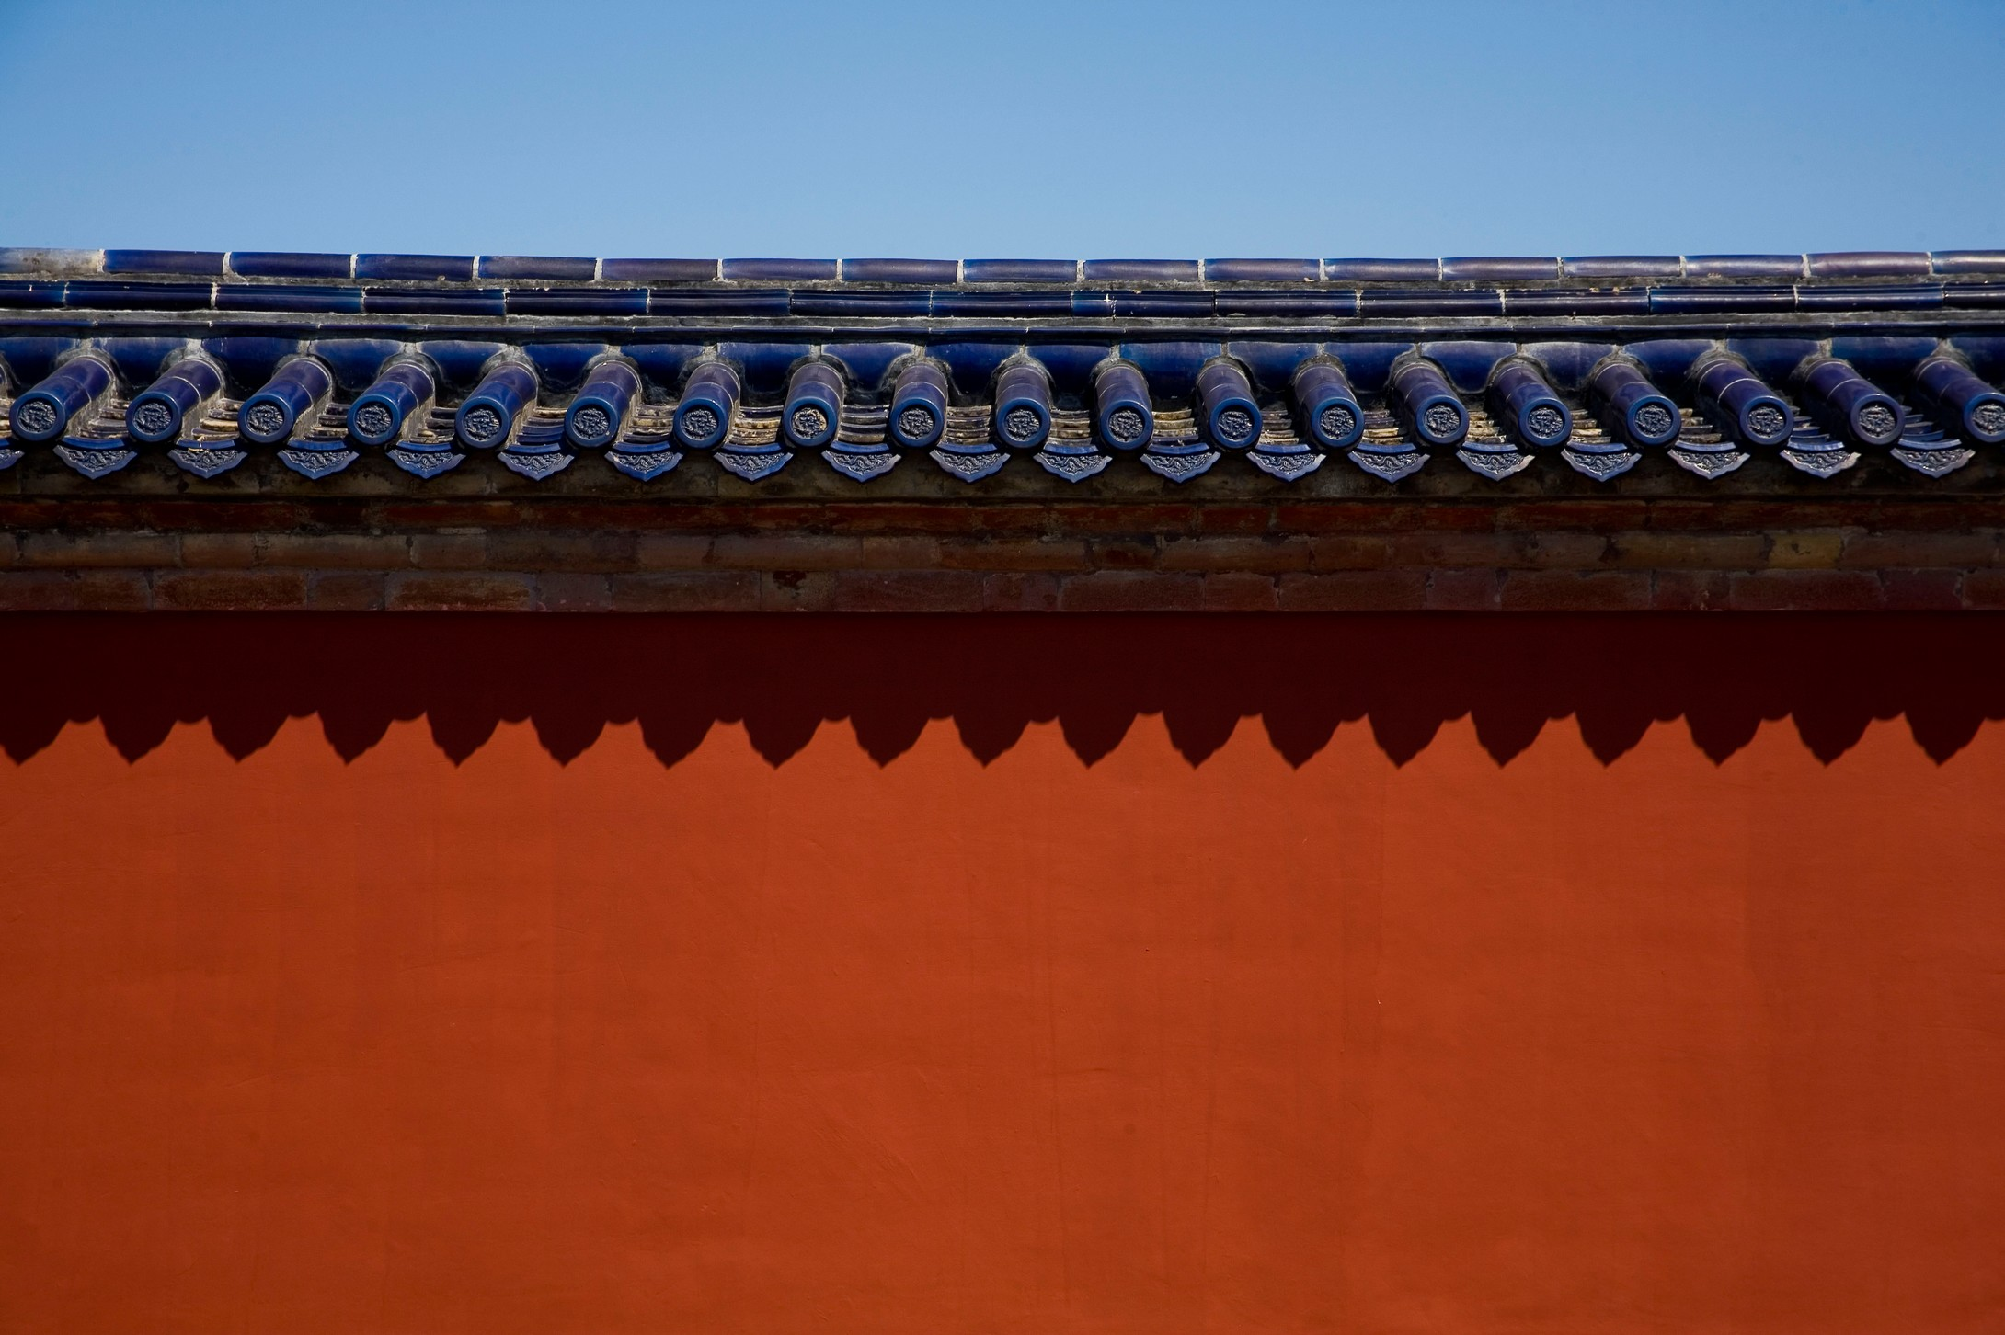
content
1.geographical location
2.Culture
3.Architecture and Cuisine
4.Scenic area

Slide 3
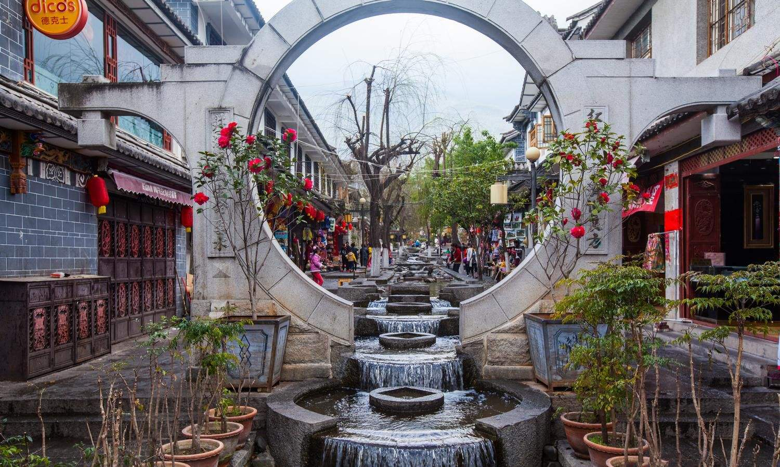
1.geographical location

Slide 4
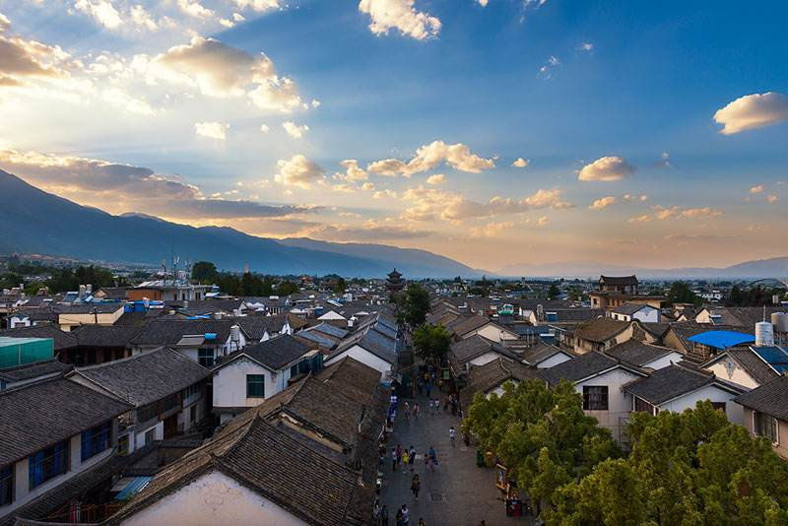
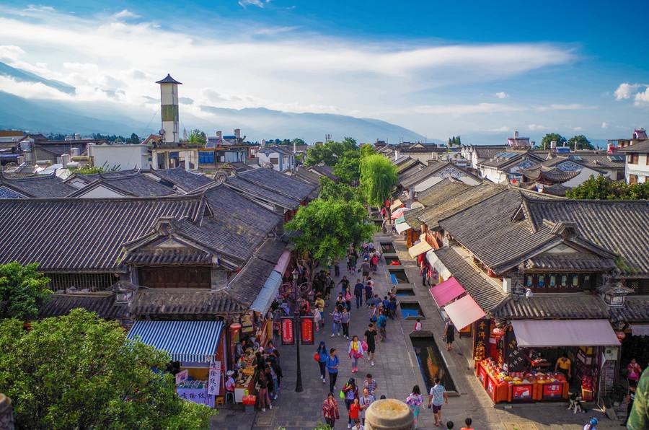
1.geographical location
Dali is located in northwest China's Yunnan province, at the southern end of the Hengduan Mountains, a plateau basin surrounded by mountains and rivers.Therefore, the annual temperature difference is small and the four seasons are not obvious.
"The four-hour atmosphere is often like early spring, cold stops in cold, summer stops at temperature"

Slide 5
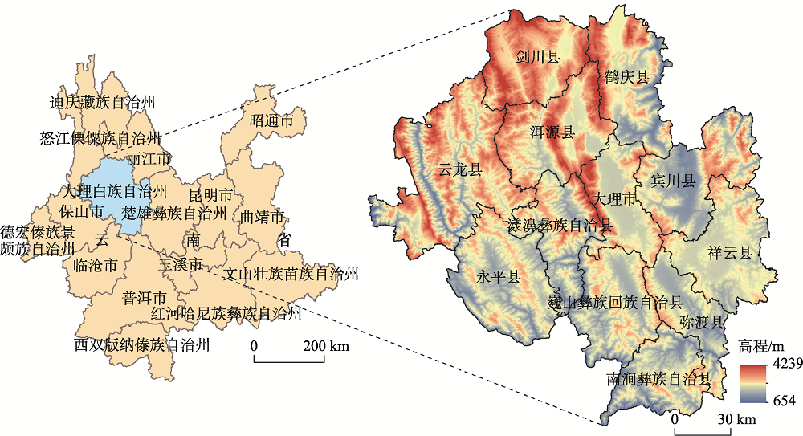
1.geographical location
Dali City, Dali Prefecture, Yunnan Province

Slide 6
2.Culture

Slide 7
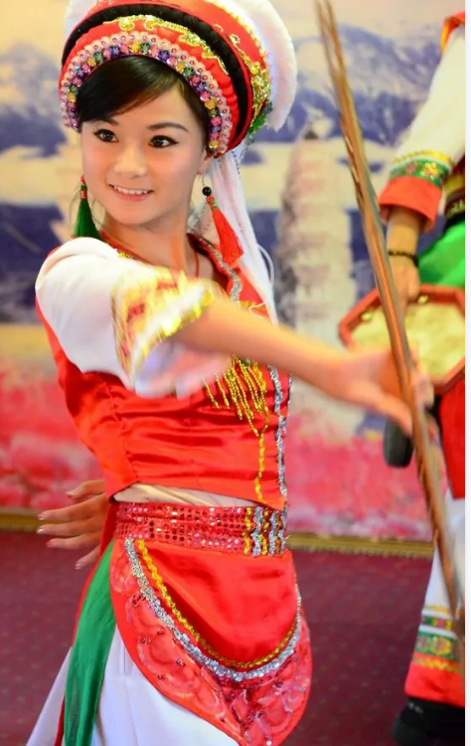
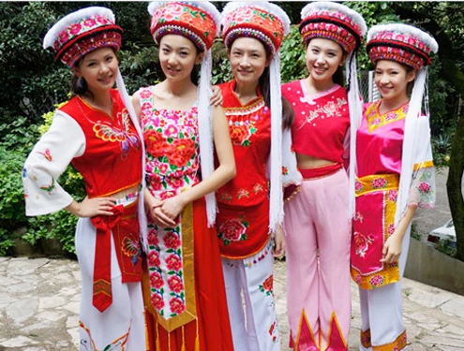
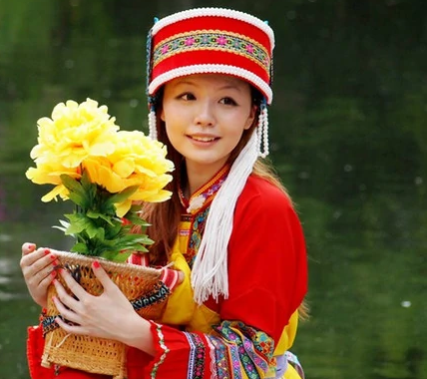
Resident population
There are 13 ethnic groups living in Dali city, including han, Bai, Yi, Hui, Lisu, Miao, Naxi, Zhuang, Zang, Brown, Lahu, Achang and Dai. There are 8 less populated ethnic groups, namely lisu, Miao, Dai, Achang, Zhuang, Tibetan, Brown, lahu and so on. The Bai nationality is the main inhabitant population.

Slide 8
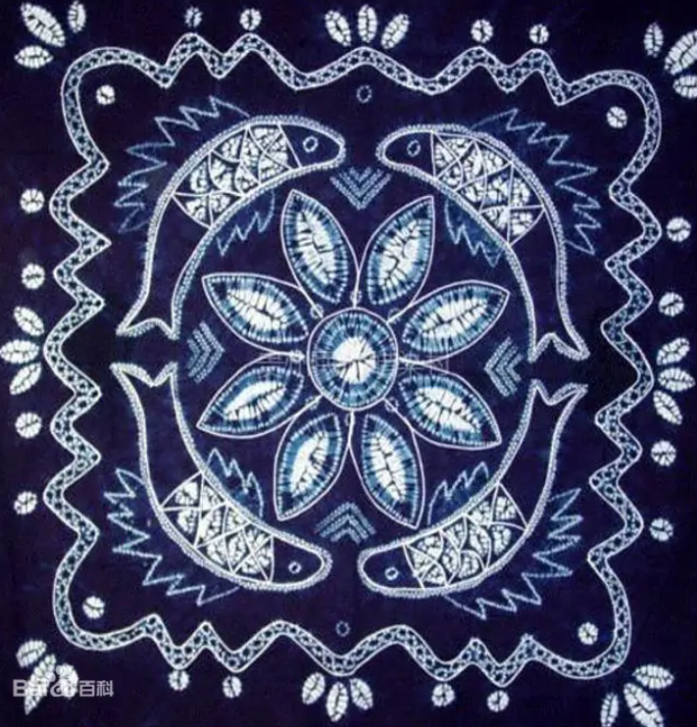
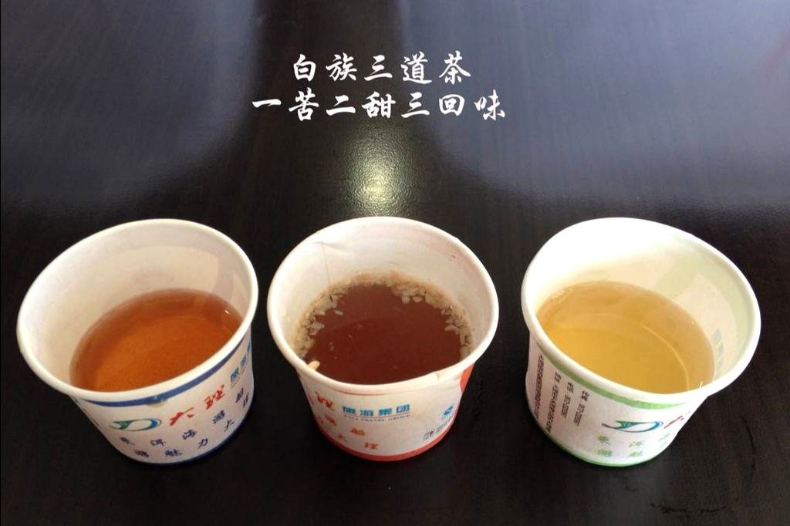
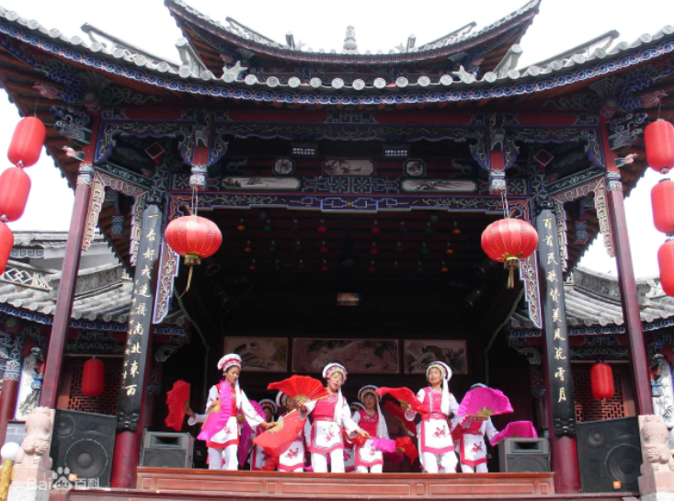
Bai culture
Three courses of tea
Bai tone
Dali tie-dye

Slide 9
3.Architecture and Cuisine

Slide 10
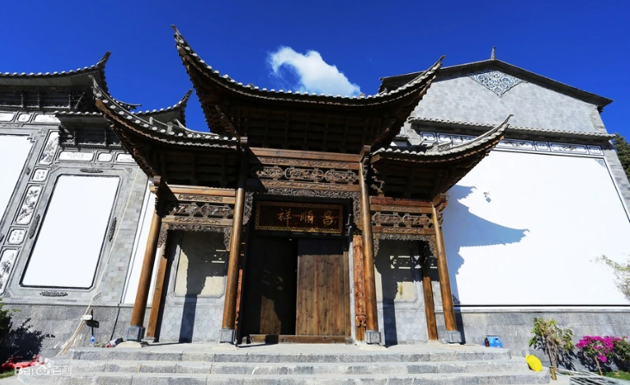
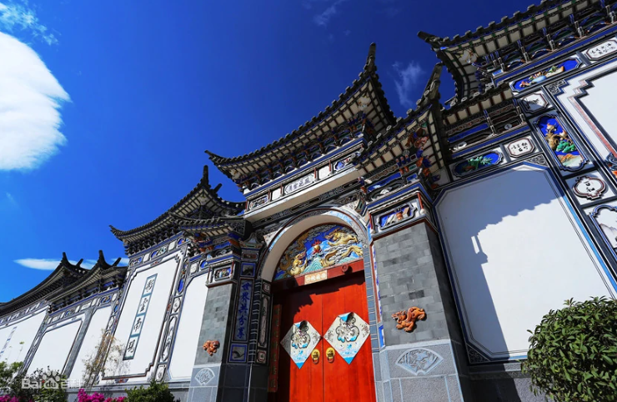
Architecture
Bai folk houses always have neat appearance, solemn, generous, white wall green tiles, simple and generous. There are generally four forms: one is "two rooms and one ear", that is, two buildings are perpendicular to each other, and there is an ear room at the intersection; The second is "three rooms one zhaobi", that is, three buildings, the main room opposite zhaobi; The third is "four in five courtyards", that is, there are four buildings, each crossing point has a wing; Four for the "six contract spring", that is, there are two big courtyard, each courtyard three buildings, each side of the corridor connected with each other, pass unimpeded, known as "walk horse turn turret".

Slide 11
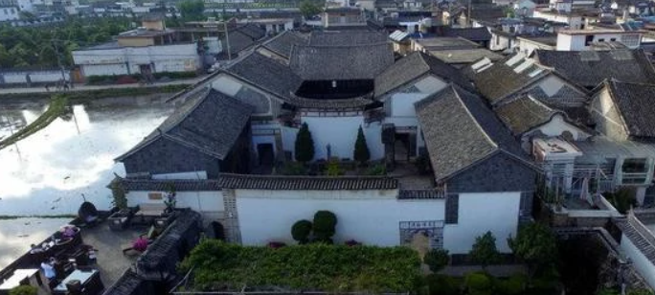
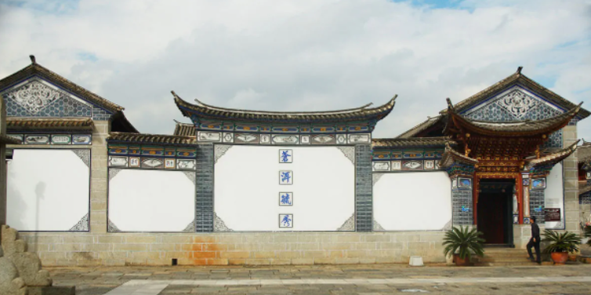
"walk horse turn turret"
“zhaobi”

Slide 12
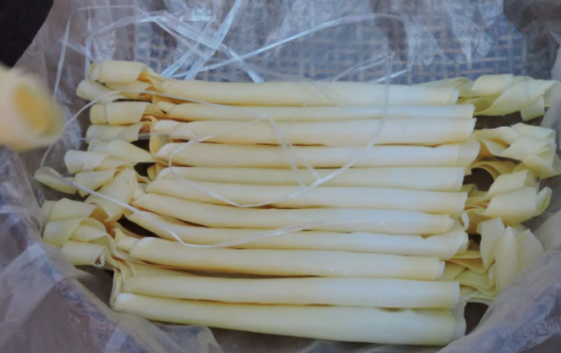
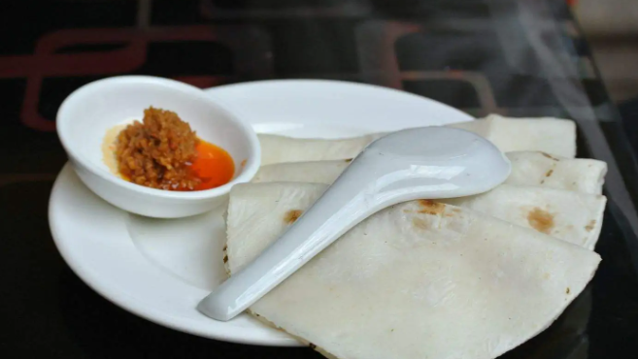
Cuisine
Dali's snacks are very distinctive, such as the famous milk fan, wonderful pieces of bait, crispy baba and smooth and tender cold chicken rice noodles. "Plum Well Restaurant" on Renmin Road is a time-honored food brand in Dali.

Slide 13
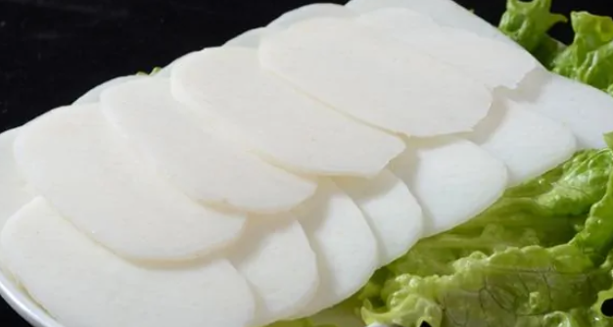
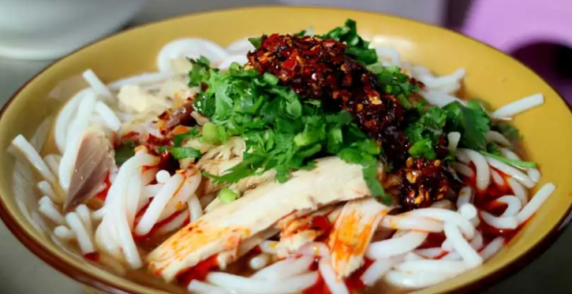
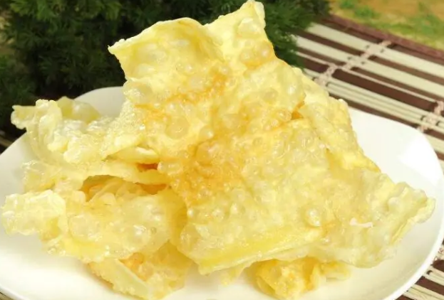
wonderful pieces of bait
smooth and tender cold chicken rice noodles
milk fan

Slide 14
4.Scenic area

Slide 15
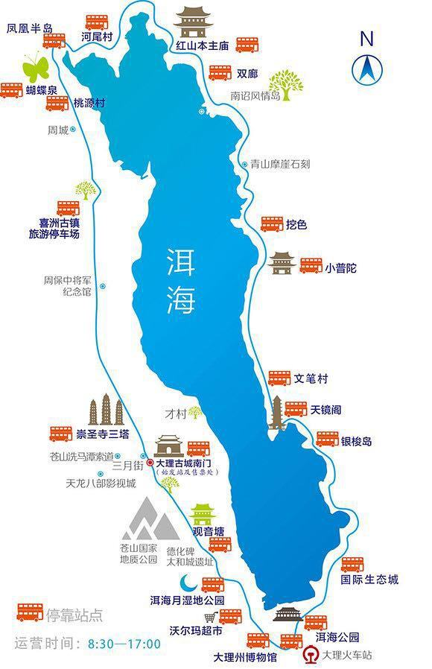
Dali state national scenic area, with a total area of 1016 square kilometers. It consists of Cangshan Erhai Scenic area, Webaoshan Scenic area, Shibaoshan Scenic area, Jizu Mountain scenic area, and Taiping Lake Scenic area.
The main scenic spots are: Erhai Lake, Cangshan Mountain, Dali Ancient City, Dali Tianlong Eight part Film and television City, Dali Digse Town, Chongsheng Temple three towers, Zhoucheng ancient village, Butterfly Spring.
Tour Bus Route

Slide 16
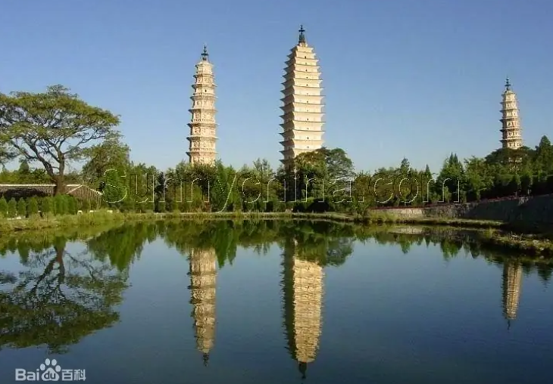
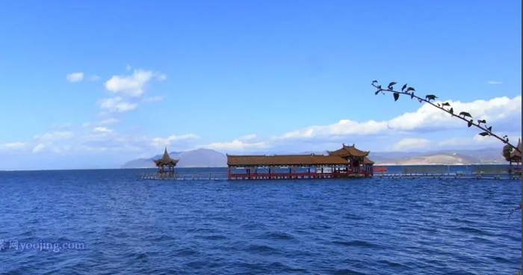
Erhai Lake
Chongsheng Temple three towers

Slide 17
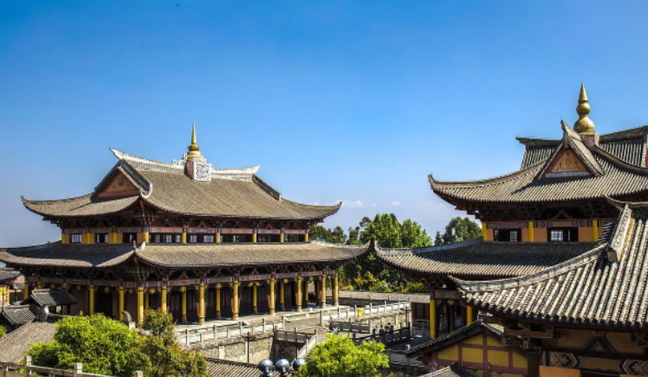
Dali Tianlong Eight part Film and television City

Slide 18
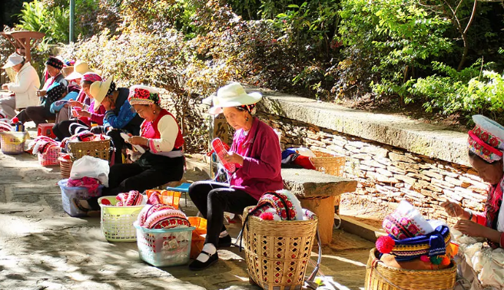
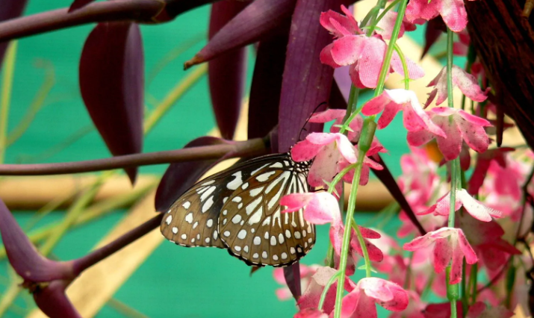
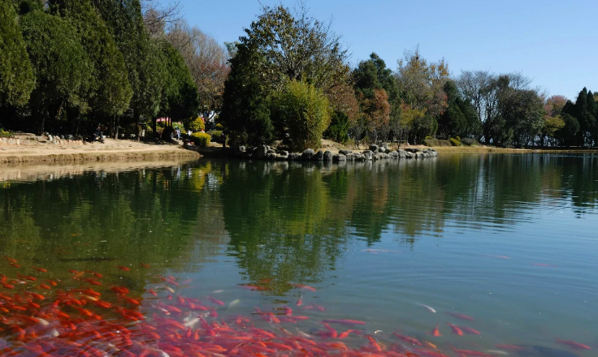
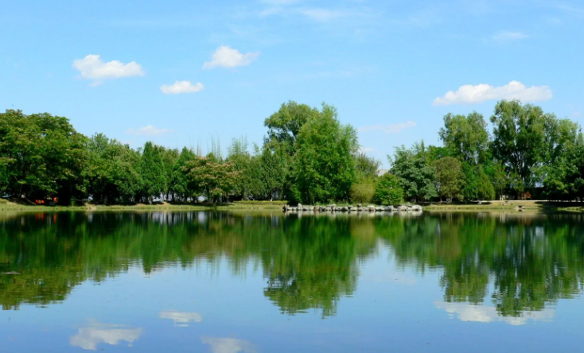
Butterfly Spring

Slide 19
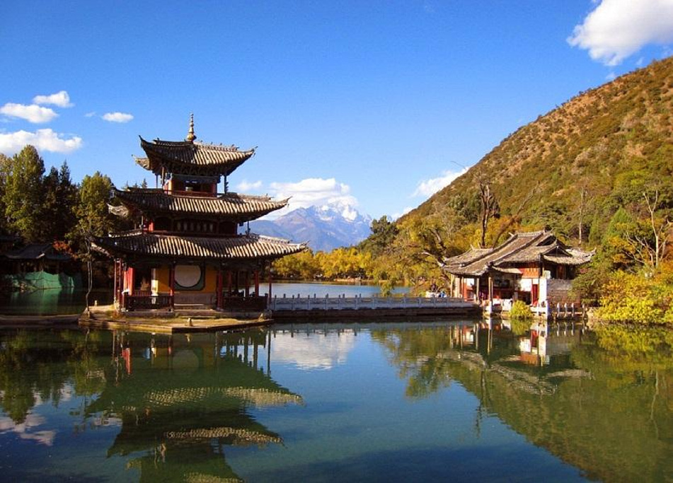
Thank you
Team members:杨晨露 何力凯 吴佳丽 张卓童 尹日尧

